Slide 1
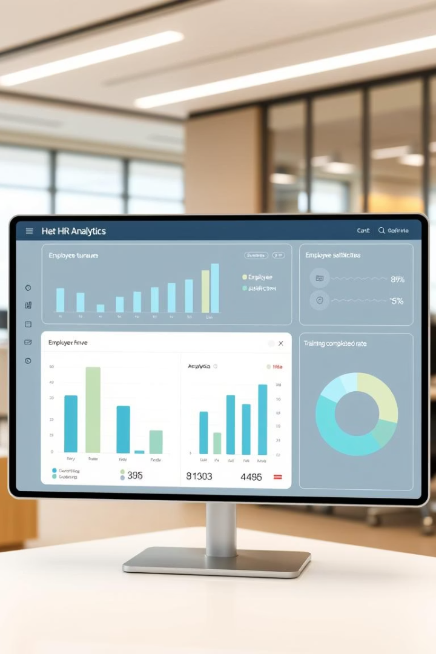
HR ANALYTICS
DASHBOARD
MODULES: Excel, Sql, Power BI, Tableau

Slide 2
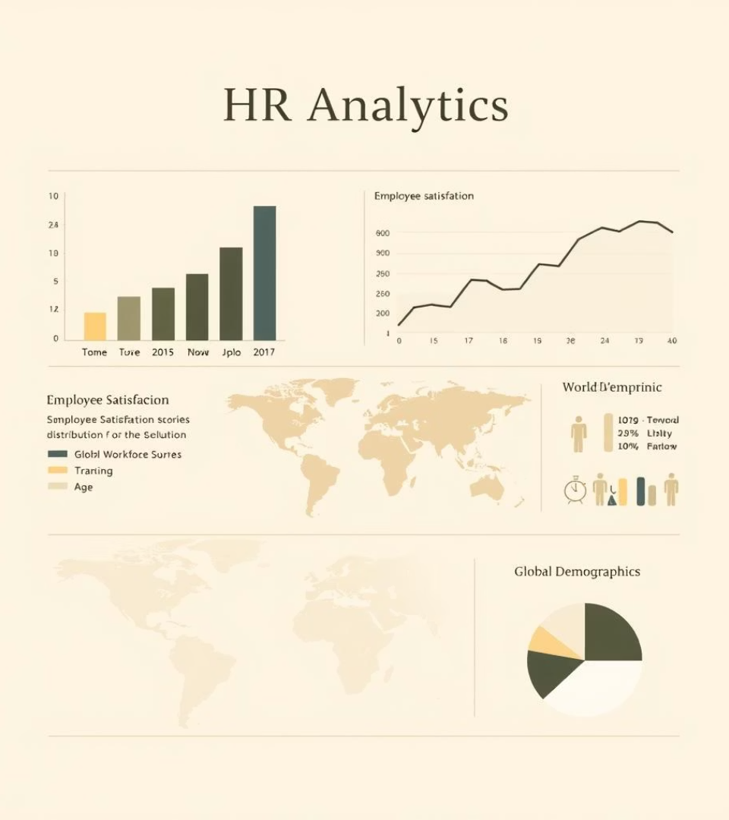
INDEX
Key Performance Indicators (KPIs)
Active Employees
Average Age of Employees
Overall Attrition Rate
Average Hourly Rate
Department-wise Attrition
Job Role vs Work-Life Balance
Attrition vs Years Since Promotion
Attrition vs Monthly Income
Avg. Working Years per Department
Gender-wise Attrition
Conclusion
Key Observations
Suggestions or Recommendations

Slide 3

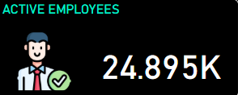
KPI 1 – Active Employees
24,895
Active Employees
The organization currently has 24,895 active employees.
The 'Active Employees' KPI reflects the total number of employees currently working in the organization.
This figure represents the existing workforce strength and reflects the company’s operational scale and human resource capacity.
Maintaining a strong base of nearly 25,000 active employees highlights the organization’s stability and continued employee retention.
This metric helps in understanding the scale at which the company is operating and assists HR in planning for workforce expansion, training, and development programs.

Slide 4
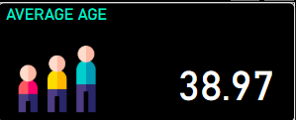
KPI 2 – Average Age of Employees
Metric: 38.97 years
Purpose
This KPI represents the average age of the current workforce, revealing whether the company has a young, mid-career, or aging employee base
To understand the age distribution of the workforce
Helps in workforce planning, benefits design, and retirement forecasting.
Insight
An average age close to 39 years indicates a mature and experienced workforce
Suggests that the organization may have a balanced mix of mid-career professionals.
A stable age group that likely requires career progression, leadership roles, and family-related benefit

Slide 5


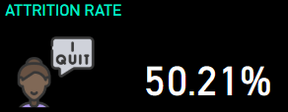

KPI 3 – Attrition Rate
Metric: 50.21%
The attrition rate indicates the percentage of employees who have left the company during a specific time frame. A 50.21% rate is critically high, suggesting every second employee is leaving.
Insight:
A 50.21% attrition rate is very high, indicating that over half of the workforce has left within the analyzed period.
May signal issues such as:
Lack of career growth or promotions.
Inadequate compensation or benefits.
Poor work-life balance or workplace culture.
Purpose
Measures employee turnover and helps evaluate workplace stability and satisfaction.
Critical for HR planning, recruitment budgeting, and employee engagement strategies.

Slide 6
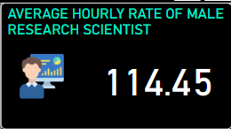
KPI 4 – Average Hourly Rate Of Male Research Scientist
Metric: ₹114.45
This KPI reflects the average hourly wage paid to male employees working in the Research Scientist job role
Purpose:To understand the average hourly compensation specific to male employees in the research scientist role.
Insights:
The chart reveals the average hourly rate, which can be compared to:-
•Other job roles
•Female Research Scientists
•Overall company average

Slide 7
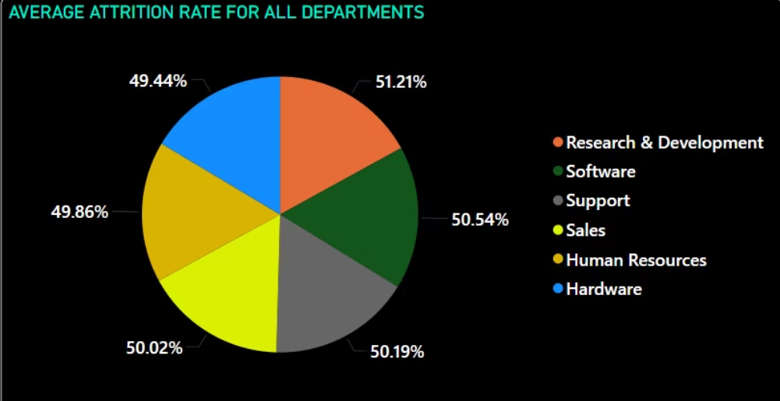
KPI 5 - Attrition Rate For All Department
All departments have a high attrition rate (around 50%), indicating potential issues with employee satisfaction, workload, or engagement.
Research & Development (51.21%) and Software (50.54%) have the highest exit rates, possibly due to job stress or lack of innovation incentives.
Hardware has the lowest attrition (49.44%) , which might reflect better team stability or job satisfaction.

Slide 8
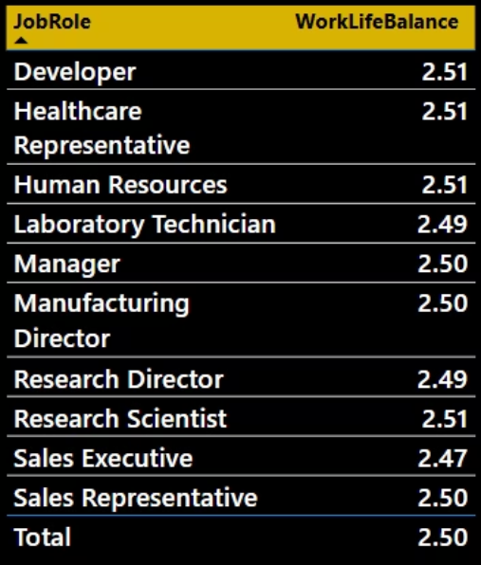
KPI 6 – Job Role vs Work-Life Balance
Lowest Score: Sales Executive – 2.47
Highest Score: Research Scientist – 2.51
Developer, Healthcare Representative, Human Resources, and Research Scientist roles report the highest WLB score of 2.51, indicating relatively better balance in their job routines.
Sales Executive has the lowest WLB score of 2.47, suggesting higher stress or longer working hours compared to other roles.
Manager, Manufacturing Director, and Sales Representative all maintain a WLB of 2.50, which is exactly on par with the company average.
Laboratory Technician and Research Director have slightly below-average scores at 2.49, showing room for improvement in these roles.

Slide 9
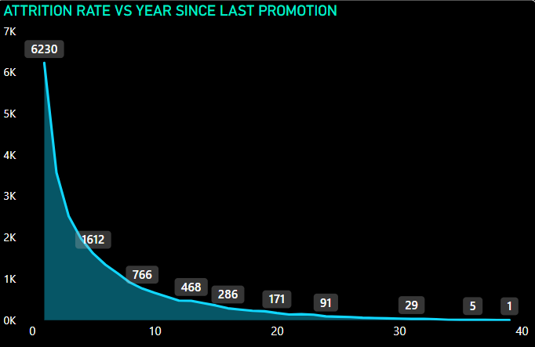
KPI 7 – Attrition vs Years Since Last Promotion
A high attrition count (6230) is seen in employees with 0 years since last promotion, indicating many employees leave before or just after a promotion cycle.
The attrition rate steeply declines as the years since last promotion increase.
Very low attrition after 20+ years since last promotion, suggesting a stable older workforce or limited active workforce in that segment.

Slide 10
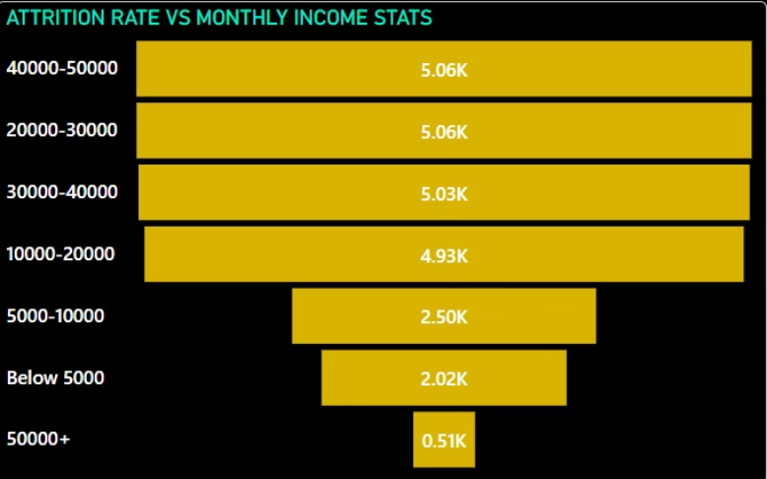
KPI 8 – Attrition Rate vs Monthly Income Stats
This graph highlights that The highest attrition is seen in the 40,000–50,000 and 20,000–30,000 ranges with 5,062 and 5,060 exits respectively.
Employees earning between 30,000–40,000 and 10,000–₹20,000 also have high attrition numbers (5,028 and 4,930), indicating dissatisfaction even in mid-income roles.
Lower-income groups like 5,000–10,000 and Below 5,000 show moderate attrition — 2,501 and 2,016 respectively.
The lowest attrition is seen in the 50,000+ bracket with only 508 cases.

Slide 11
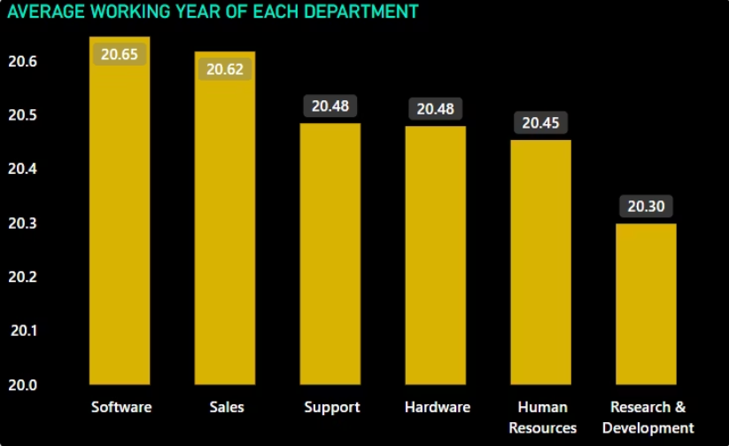
KPI 9 - Average Working Year For Each Department
Software department has the highest average working year (20.65), indicating strong retention or experienced employees.
Sales follows closely with 20.62 average working years.
Support and Hardware departments show equal tenure at 20.48 years.
Human Resources slightly lower at 20.45 years.
Research & Development has the lowest average tenure (20.30), which might indicate recent hires or higher attrition.

Slide 12
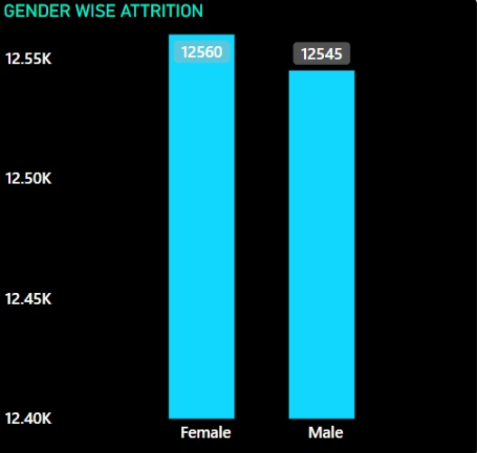
KPI 10 - Gender Wise Attrition
The chart displays the number of male and female employees who left the organization.
Female attrition (12,560) is slightly higher than male attrition (12,545).
The attrition is almost evenly split between both genders, indicating a balanced gender impact in terms of employee exits.

Slide 13
CONCLUSION
KEY OBSERVATION :-
Strong Workforce Capacity 🔸 Active Employees: 24.9K ➤ Indicates a stable and scalable workforce, but maintaining quality talent requires consistent retention strategies.
Concerning Attrition Trends 🔸 Attrition Rate High in Employees with <2 Years Tenure ➤ Suggests onboarding experience, early engagement, or compensation gaps need urgent attention.
Stagnation in Career Growth 🔸 Many Employees Not Promoted in Last 2–4 Years ➤ Indicates a bottleneck in the promotion pipeline, leading to dissatisfaction and potential exits.
Work-Life Balance Gaps by Role 🔸 Low Ratings for Sales, Healthcare & Operations Roles ➤ May contribute to higher burnout and turnover in key operational functions.
Tenure Disparity Across Departments 🔸 R&D and Sales Show Lower Average Tenure ➤ Indicates retention and engagement issues that need department-level focus.

Slide 14

💡 Suggestions to Improve Performance
Implement a Targeted Retention Strategy
Focus on new hires (<2 years) with regular check-ins, mentorship, and faster feedback cycles.
Create Transparent Career Growth Paths
Develop and share clear promotion criteria and timelines by department and job role.
Launch Role-Specific Engagement Initiatives
Tailor flexible work policies and wellness programs for high-stress roles like Sales
and Support.
Introduce Salary Reviews & Equity Adjustments
Regularly benchmark and adjust salaries to maintain fairness and recognize employee
contributions.
Strengthen Departmental HR Support
Provide R&D and Sales with tailored retention and development plans to reduce turnover.
Encourage Cross-Functional Use of HR Dashboards
Train team leads and managers to use Power BI dashboards for real-time workforce
decisions, trend tracking, and performance planning

Slide 15

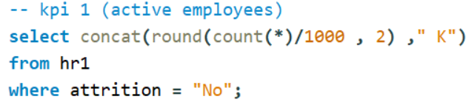
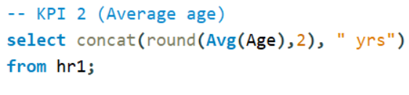
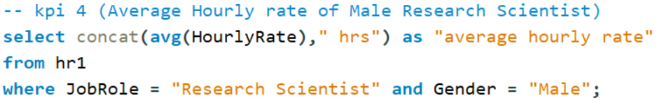
SQL Query for KPIs

Slide 16
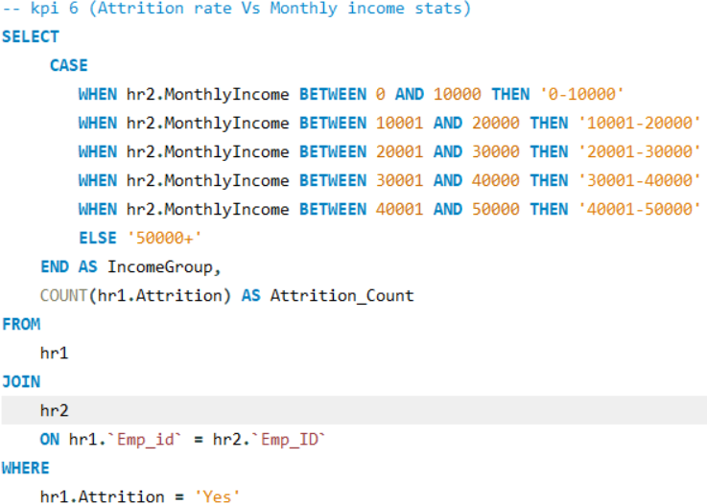
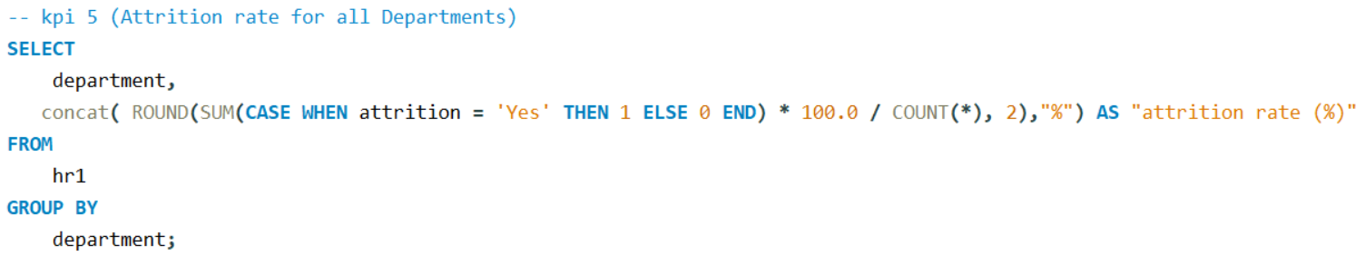
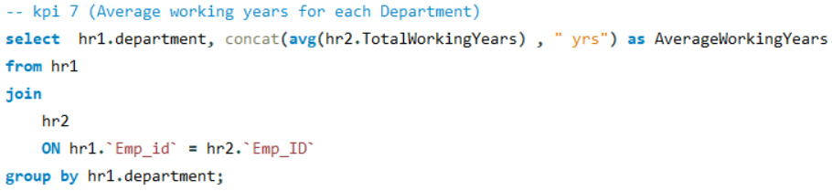
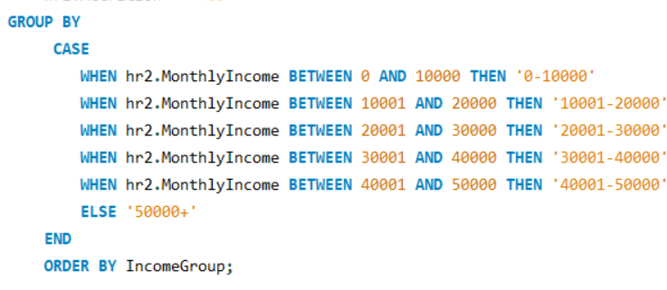

Slide 17
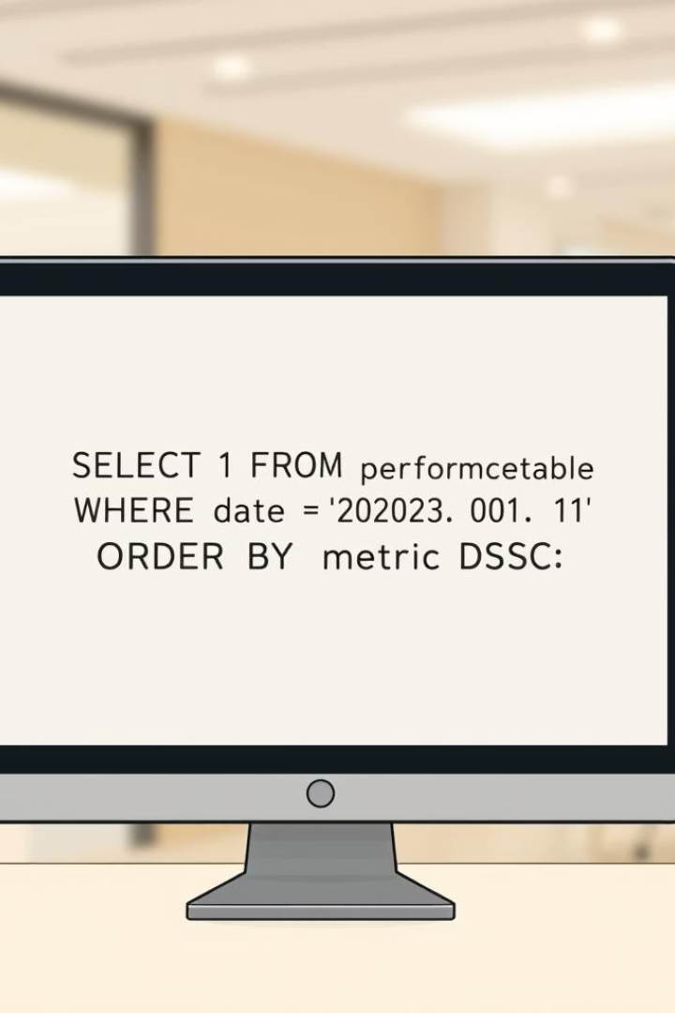
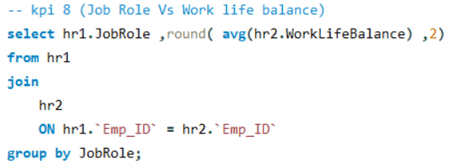
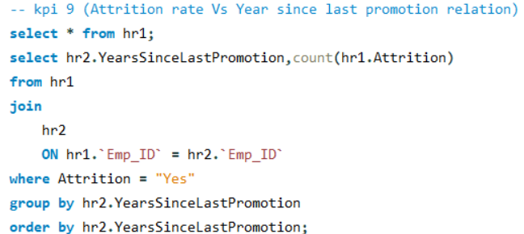
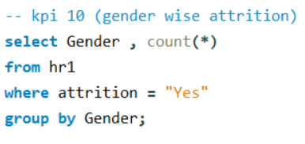

Slide 18
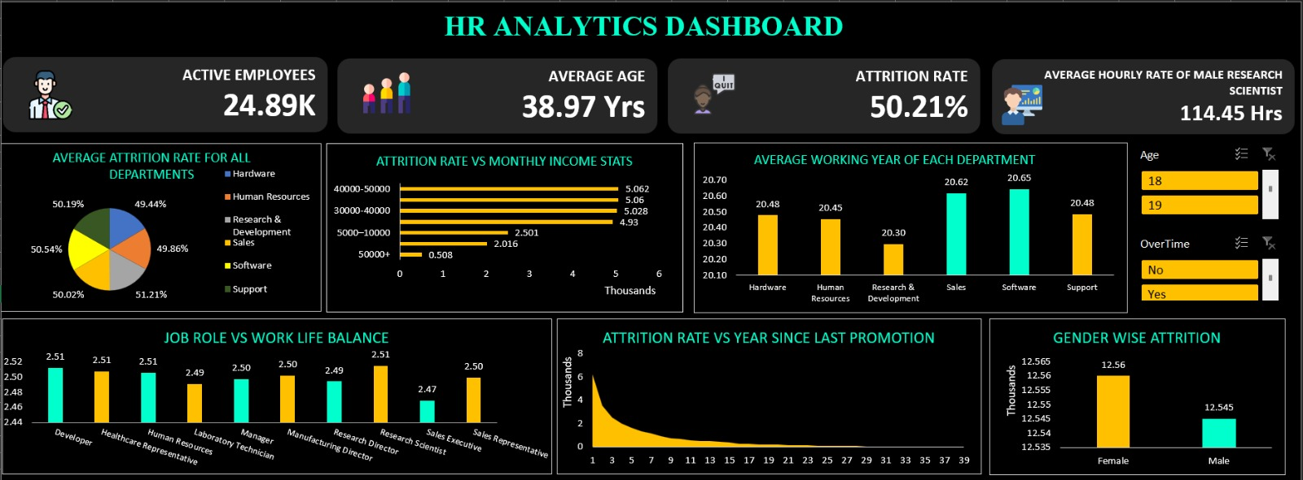
EXCEL DASHBOARD

Slide 19
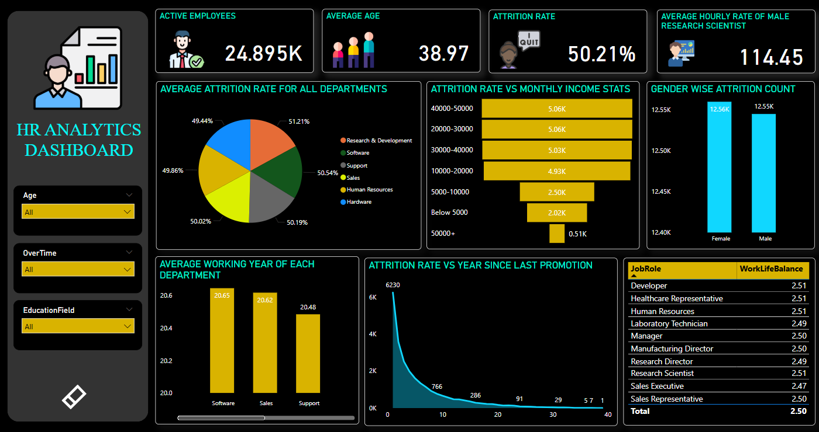
POWER BI DASHBOARD

Slide 20
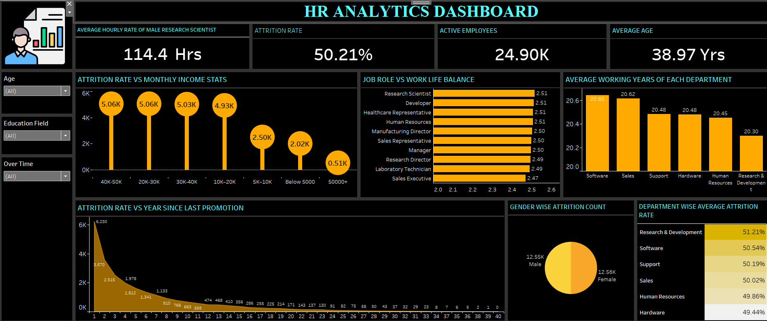
TABLEAU DASHBOARD

Slide 21

THANK YOU!!

